Slide 2


Slide 3







Slide 4
Unicorns
Startups need money to not only survive but to grow, i.e., expand operations and acquire/serve more customers
Companies raise funding from investors such as venture-capital firms
Unicorns are private companies with a valuation of $1 billion USD or higher
Most unicorns have gone through multiple funding rounds, each round usually increases their valuation
Many unicorns especially those in the software industry are technological juggernauts with a focus on innovation
Unicorns also have broad socio-economic impact

Slide 5

Unicorns: Focus in the media^{1,2}
Notes:
https://www.nytimes.com/2019/03/07/style/uber-ipo-san-francisco-rich.html
http://fortune.com/2015/01/22/the-age-of-unicorns/

Slide 6
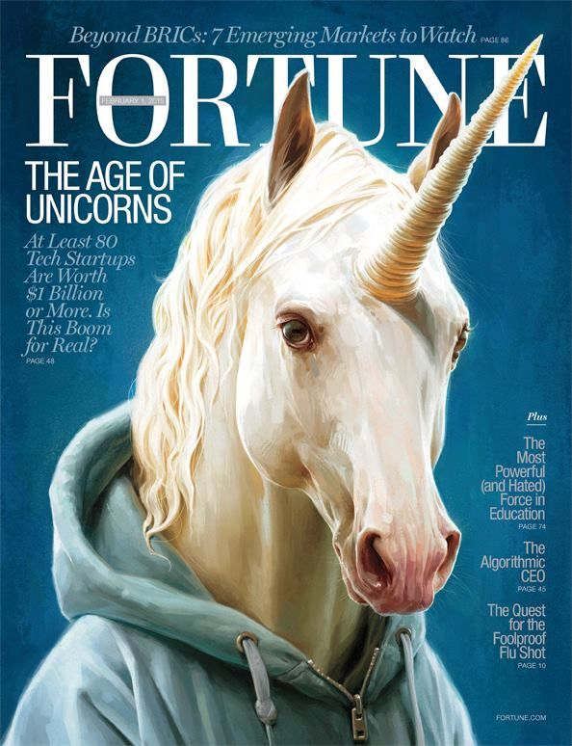
Notes:
2. http://fortune.com/2015/01/22/the-age-of-unicorns/

Slide 7
Data set characteristics
117 U.S. unicorn startups
Goal: Build a model to predict valuation
Predictors
Annual Revenue
Total funding
Number of acquired companies
Number of funding rounds
Number of investors
Number of founders
Age of company

Slide 8
EDA Results
Scatterplots and correlation matrix indicates the strong linear association of valuation with the revenue and funding predictors.
High correlation values between revenue and funding predictors = Possible multicollinearity?
Several observations that are outliers and/or have high leverage
Other issues: interpreting annual revenue
Annual revenue, unlike total funding and valuation, is not a cumulative number
Revenue (usually) ≠ profit
Inflated annual revenue
Notes:
Also mention difficulty of gathering accurate revenue information

Slide 11
Modeling Methodologies
Test-set validation
Dimension reduction is critical
Feature selection with regsubsets() and lasso regression
Feature projection with PCR() and PLSR()
Linear regression, polynomial regression
Bootstrap estimate of regression coefficients and accuracy
10-fold Cross-validation

Slide 13
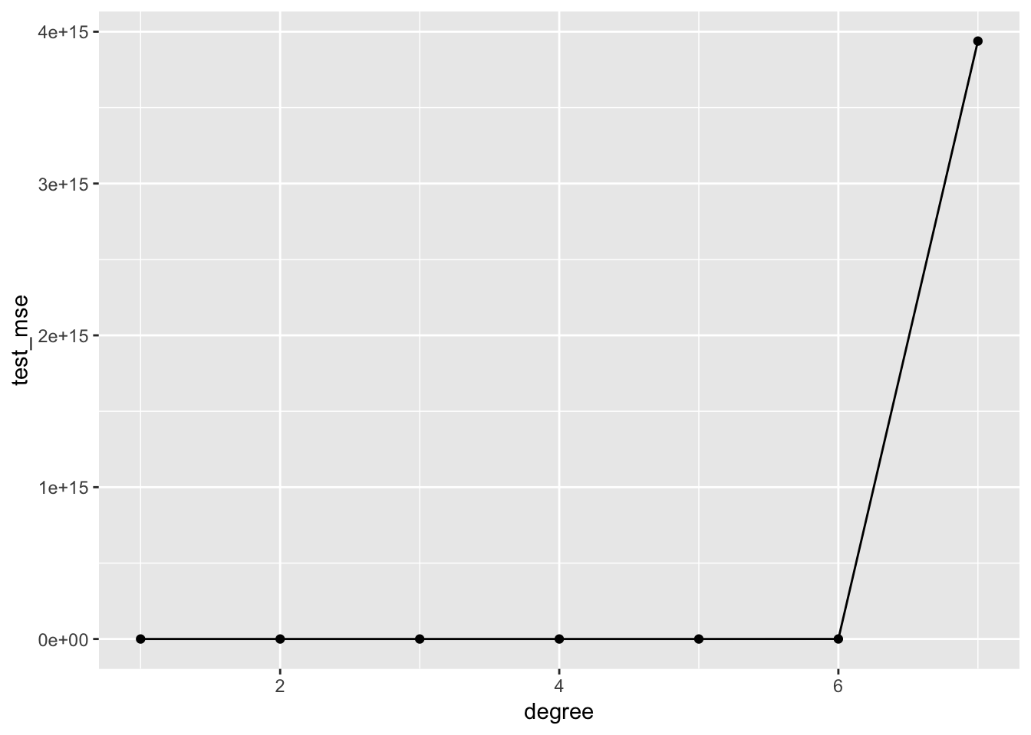

Slide 14
Modeling Results
First subset of predictors from regsubsets(): total funding, annual revenue, the number of funding rounds, the number of years it took for the startup to reach unicorn status, and the age of the startup.
Second subset of predictors from lasso regression: total funding, annual revenue, and the number of acquisitions
Test MSEs of a linear model with each subset above: 0.19 and 0.21
Lasso, PCR(), and PLSR() test MSEs: 17.31 – 22.16
lm("valuation_b ~ acquistions + funding_b : revenue_b”, …) test MSE: 0.001703965

Slide 15
Valuation Boxplot

Slide 16
Cross-validation results
lm("valuation_b ~ acquistions + funding_b : revenue_b”, …) average CV MSE: 1206
Model | Test Set Validation MSE | Average CV MSE
Linear | 0.19-0.21 | 23.5-29.6
PCR | 14.62 - 22.1 | 34.4-38.3
PLSR | 14.62 - 22.1 | 21.6 - 26.1

Slide 17
Conclusion
PLSR model has lowest average CV test MSE. “valuation ~ age + funding_b + revenue_b + rounds + growth_years”. Number of components: 3.
Overall statistical model is inaccurate and not precise for purpose of predicting a unicorn’s specific valuation
However, the model does help partially explain factors that contribute to a unicorn’s valuation
Need to expand scope of data set to collect more observations
Annual profit and number of employees more accurate and reliable metrics of companies’ financial health

